Slide 1


Thasindu Amarasinghe
11/20/2025

Slide 2

Outline
Executive Summary
Introduction
Methodology
Results
Conclusion
Appendix

Slide 3
Executive Summary
• In this capstone project, we will predict if the SpaceX Falcon 9 first stage will land successfully using several machine learning classification algorithms.
• The main steps in this project include:
Data collection, wrangling, and formatting
Exploratory data analysis
Interactive data visualization
Machine learning prediction
• Our graphs show that some features of the rocket launches have a correlation with the outcome of the launches, i.e., success or failure.
• It is also concluded that decision tree may be the best machine learning algorithm to predict if the Falcon 9 first stage will land successfully.

Slide 4
Introduction
In this capstone project, our goal is to predict whether the Falcon 9 first stage will successfully land. SpaceX advertises Falcon 9 launches at around $62 million, while competitors may charge over $165 million per launch. A major reason for SpaceX’s lower cost is its ability to reuse the first-stage booster. Therefore, accurately predicting whether the booster will land helps estimate launch costs and can be valuable for other companies aiming to compete with SpaceX.
It’s important to note that many unsuccessful landings are intentional—SpaceX sometimes performs controlled landings in the ocean.
The central question we aim to answer is: Given a set of launch features—such as payload mass, orbit type, launch site, and more—can we predict whether the Falcon 9 first stage will land successfully?

Slide 5

Section 1

Slide 6
Methodology
The overall methodology includes:
1. Data collection, wrangling, and formatting, using:
• SpaceX API
• Web scraping
2. Exploratory data analysis (EDA), using:
• Pandas and NumPy
• SQL
3. Data visualization, using:
• Matplotlib and Seaborn
• Folium
• Dash
4. Machine learning prediction, using
• Logistic regression
• Support vector machine (SVM)
• Decision tree
• K-nearest neighbors (KNN)

Slide 7
Data Collection
The dataset was assembled using several data collection techniques:
We retrieved launch data from the SpaceX API using GET requests.
The API response was decoded from JSON using the .json() method and then converted into a pandas DataFrame using json_normalize().
After loading the data, we performed cleaning operations, checked for missing values, and filled them where necessary.
Additionally, we used web scraping with BeautifulSoup to gather Falcon 9 launch records from Wikipedia.
Our goal was to extract the launch records from an HTML table, parse the data, and convert it into a pandas DataFrame for further analysis.

Slide 8
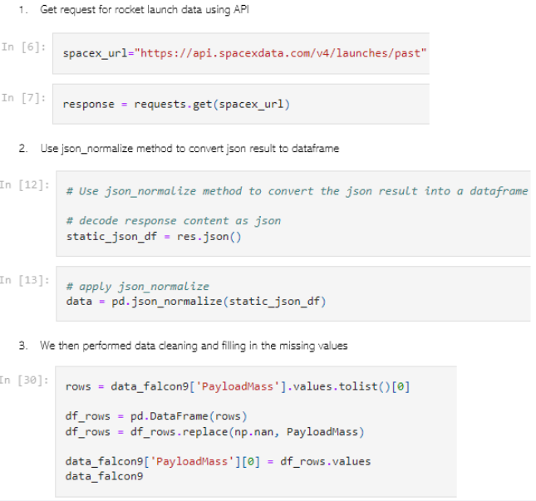
Data Collection – SpaceX API
We sent a get request to the API and obtained the data and did some basic data wrangling
Add the GitHub URL of the completed SpaceX API calls notebook (must include completed code cell and outcome cell), as an external reference and peer-review purpose
Place your flowchart of SpaceX API calls here

Slide 9
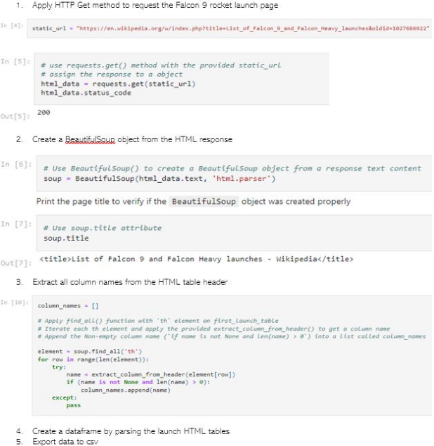
Data Collection - Scraping
We used beautifulsoup for webscraping and put that data into a pandas dataframe
Add the GitHub URL of the completed web scraping notebook, as an external reference and peer-review purpose

Slide 10
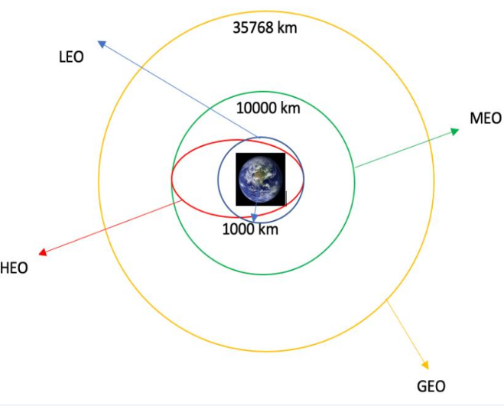
Data Wrangling
We used EDA to analyze the data to determine the training factors.
We calculated the number of launches from each site and the orbits
We created an outcome table from the table
Add the GitHub URL of your completed data wrangling related notebooks, as an external reference and peer-review purpose

Slide 11
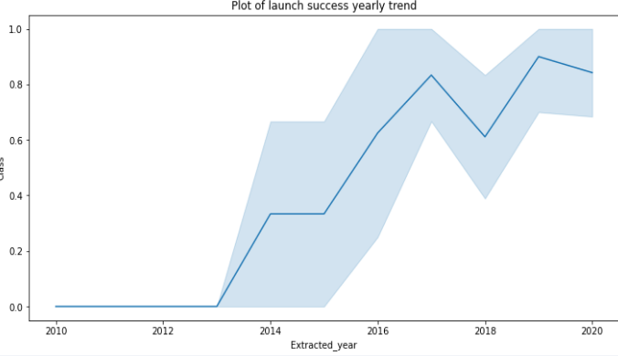

EDA with Data Visualization
We explored the data by seeing which landing site,orbit,payload had the best success rate and the yearly success trend.
Add the GitHub URL of your completed EDA with data visualization notebook, as an external reference and peer-review purpose

Slide 12
EDA with SQL
We used a postgresql database to upload our data.
We applied EDA to that database to get,
Names of launch sites
Total payload mass
Averge payload mass
Total success and failure outcomes
Add the GitHub URL of your completed EDA with SQL notebook, as an external reference and peer-review purpose

Slide 13
Build an Interactive Map with Folium
We marked the launch sites and added objects like lines rounds markers etc to show the data better.
We assigned outcomes to the locations
We used color based markers to show the outcomes
We calculated the distance between a lunch site and other stuff near them
Add the GitHub URL of your completed interactive map with Folium map, as an external reference and peer-review purpose

Slide 14
Build a Dashboard with Plotly Dash
We used dash to build an interactive dashboard
We used it to present our charts showing total launches by a site
We used it to show the relationship between payload and outcome
Add the GitHub URL of your completed Plotly Dash lab, as an external reference and peer-review purpose

Slide 15
Predictive Analysis (Classification)
We had the data in a pandas dataframe and transformed it using scikit learn and split into training and testing sets
Then we used GridSearchCV to tune the different hyperparameters
We used the accuracy as our main factor for this model and we further tuned it to improve accuracy
We found the best model by doing so
Add the GitHub URL of your completed predictive analysis lab, as an external reference and peer-review purpose

Slide 16
Results
Exploratory data analysis results
Interactive analytics demo in screenshots
Predictive analysis results

Slide 17

Section 2

Slide 18
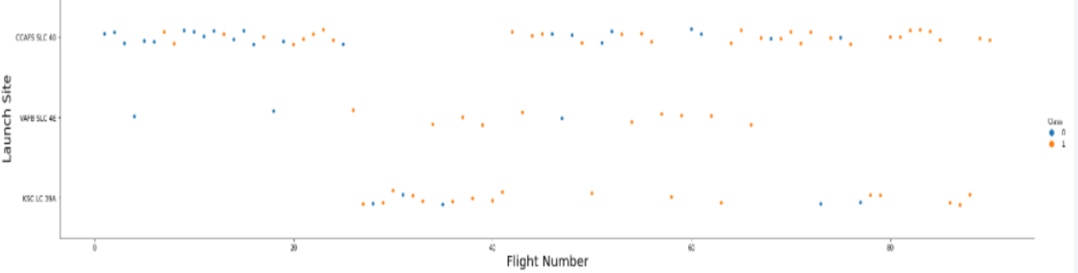
Flight Number vs. Launch Site
We found that more flight numbers mean a greater success rate.

Slide 19
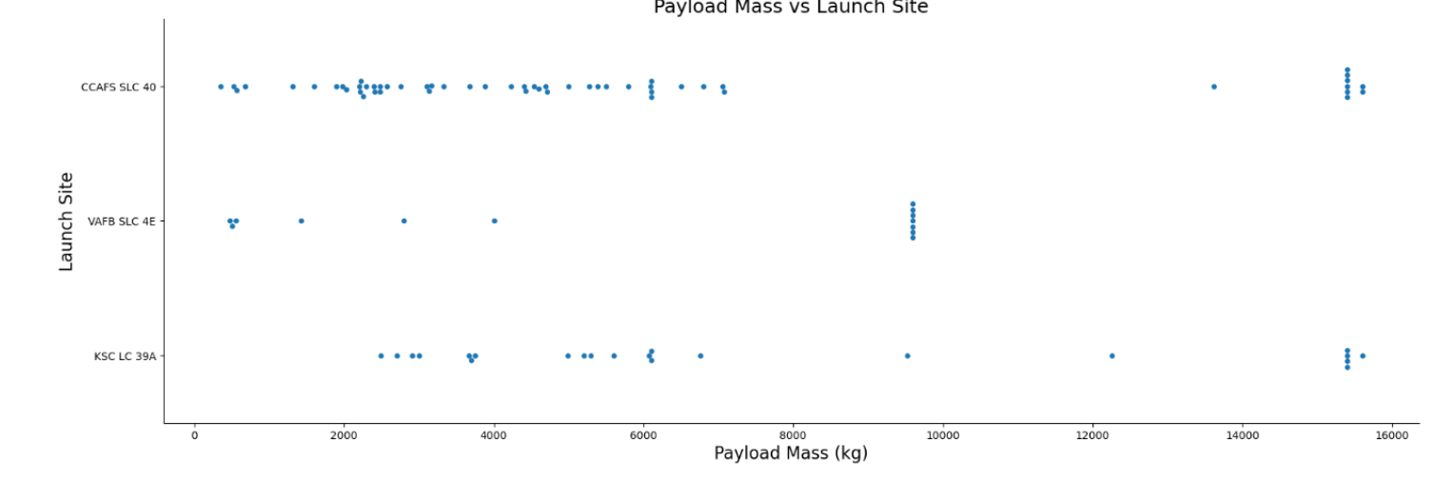
Payload vs. Launch Site
Different launch sites have different capacities for example the CCAFS SLC 40 handle payloads below 10 000kg while others have a greater range of masses

Slide 20
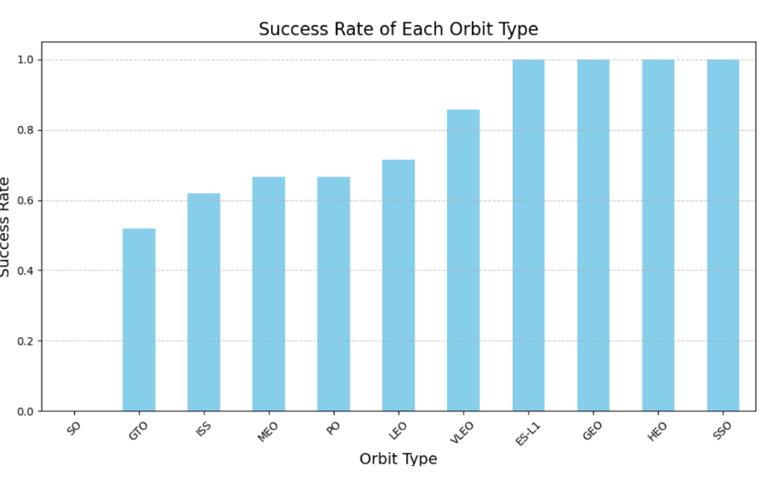
Success Rate vs. Orbit Type
We can see that VLEO ES-L1, GEO, HEO, and SSO have the highest success rate
And GTO has the lowest meaning its lower than the rest

Slide 21
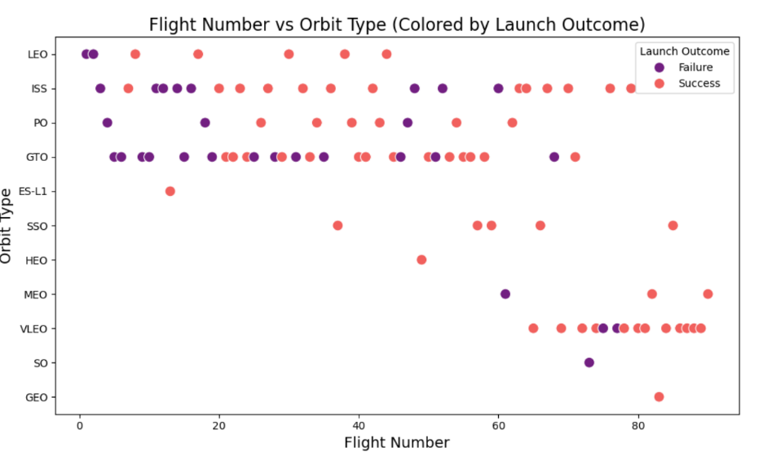
Flight Number vs. Orbit Type
We can see as the flight number increases the success rate also increases
And GTO and ISS orbits see better performance recently showing its improved

Slide 22
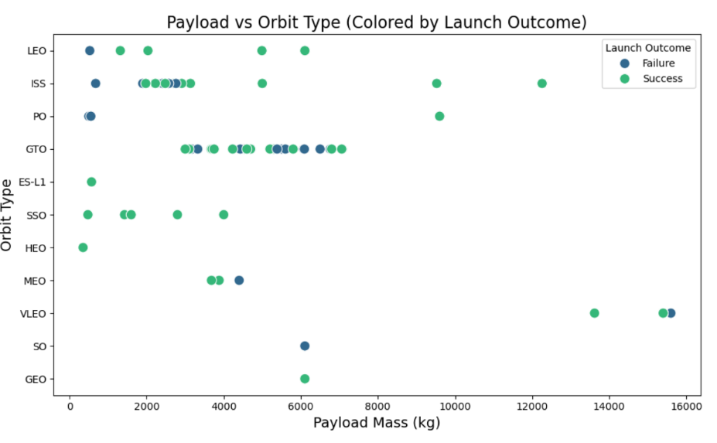
Payload vs. Orbit Type
When the payload is less than 6000kg the success rate is higher
When the payload is high the success rate drops

Slide 23
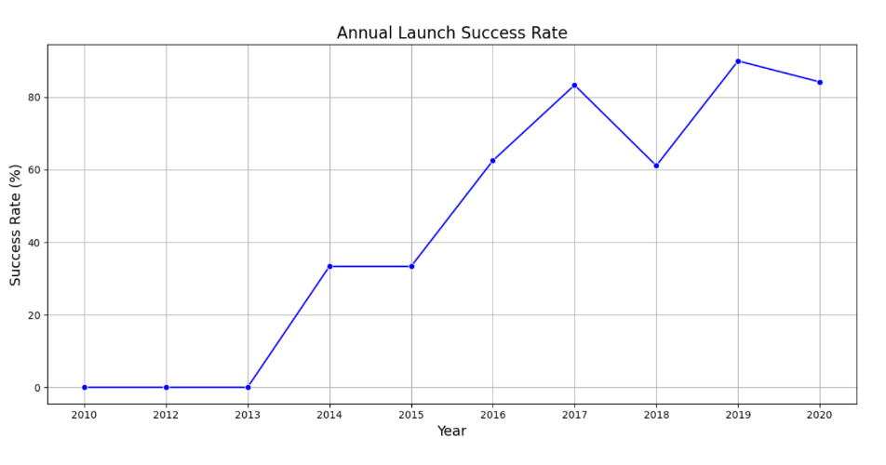
Launch Success Yearly Trend
We can see a clear improvement over the years reaching over 80% by 2020
This indicates the reliability of spaceX

Slide 24
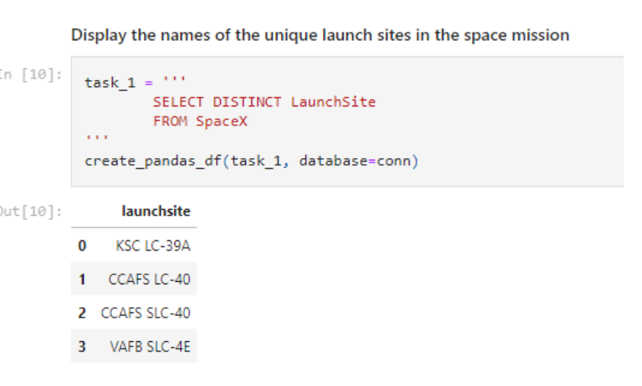
All Launch Site Names
We found the unique names of all the launch sites by SQL by using the keyword DISTINCT

Slide 25
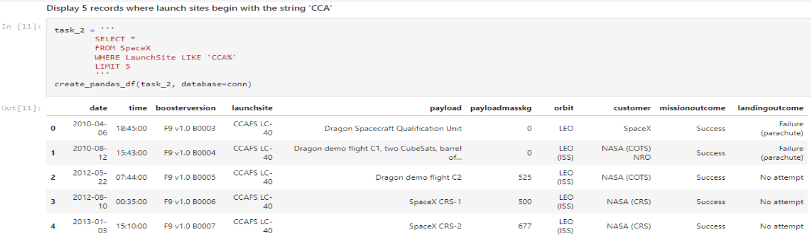
Launch Site Names Begin with 'CCA'
Then by using WHERE we found the launch sites starting with CCA

Slide 26
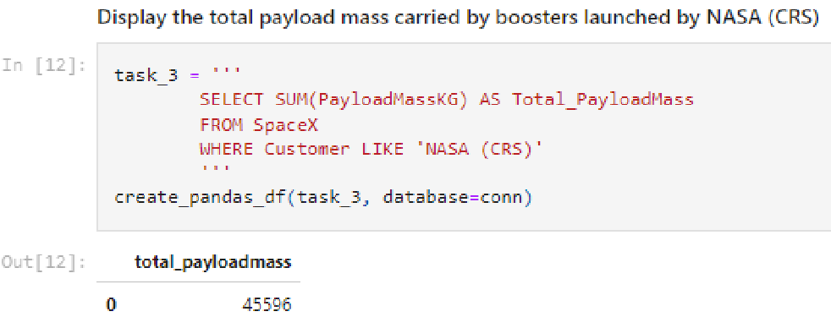
Total Payload Mass
We calculated the total mass by booster from NASA

Slide 27
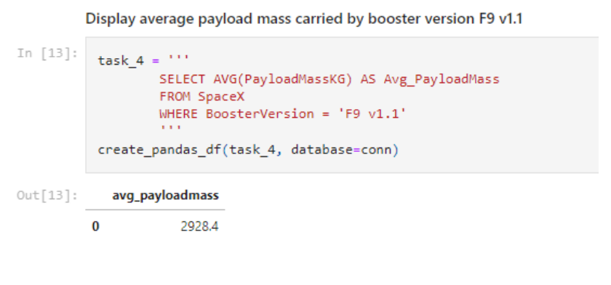
Average Payload Mass by F9 v1.1
We found the avg payload mass by the F9 v1.1 using SQL

Slide 28
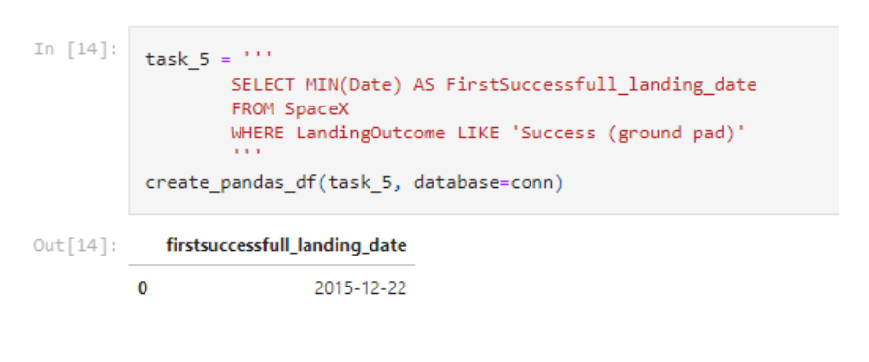
First Successful Ground Landing Date
We found the first successful landing date

Slide 29
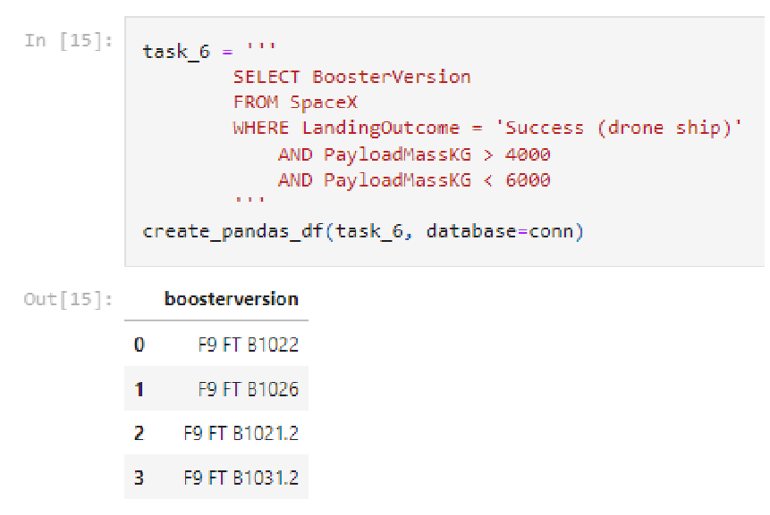
Successful Drone Ship Landing with Payload between 4000 and 6000
By the aid of the where clause we found the successful drone ship landings and we used AND to determind the payload

Slide 30
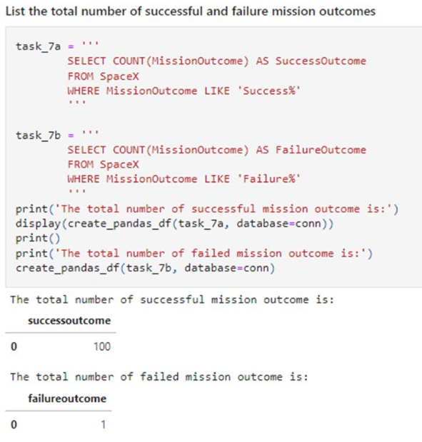
Total Number of Successful and Failure Mission Outcomes
We found the count of the total successful and failed missions

Slide 31
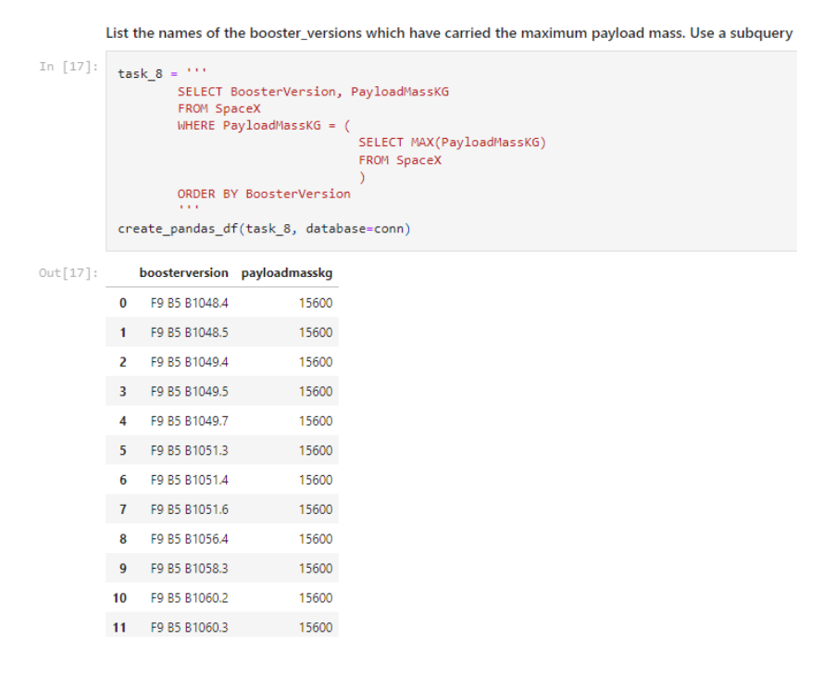
Boosters Carried Maximum Payload
We found the boosters caried maximum payload using the MAX and WHERE keywords

Slide 32
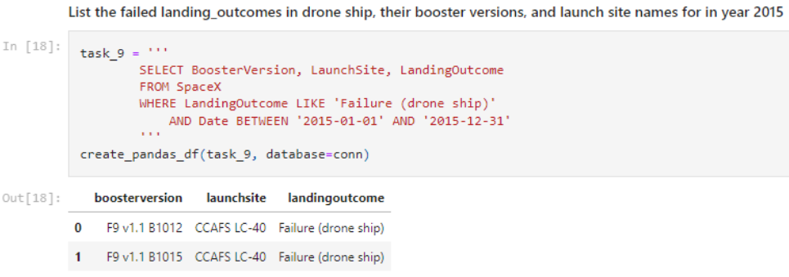
2015 Launch Records
We used a combination of keywords like WHERE AND LIKE and BETWEEN to determind this data

Slide 33
Rank Landing Outcomes Between 2010-06-04 and 2017-03-20
We used GROUP BY AND ORDER BY to determine these

Slide 34

Section 3

Slide 35
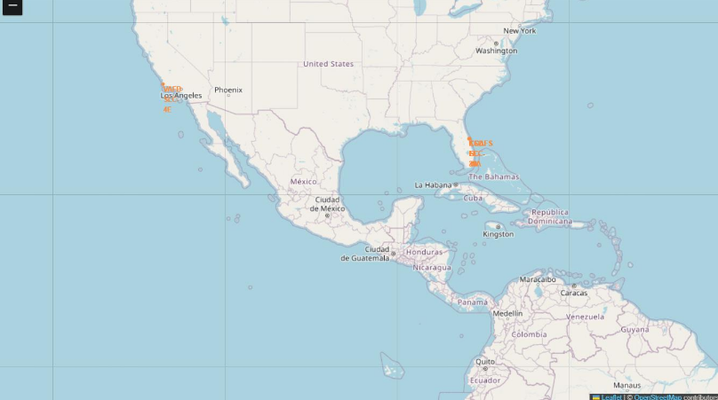
All the launch sites on a map
We can see all the launch sites are near to the coast including CCAFS LC-40 and CCAFS SLC-40 and the KSC LC-39A sites in florida and VAFB SLC-4E is also near the coast

Slide 36
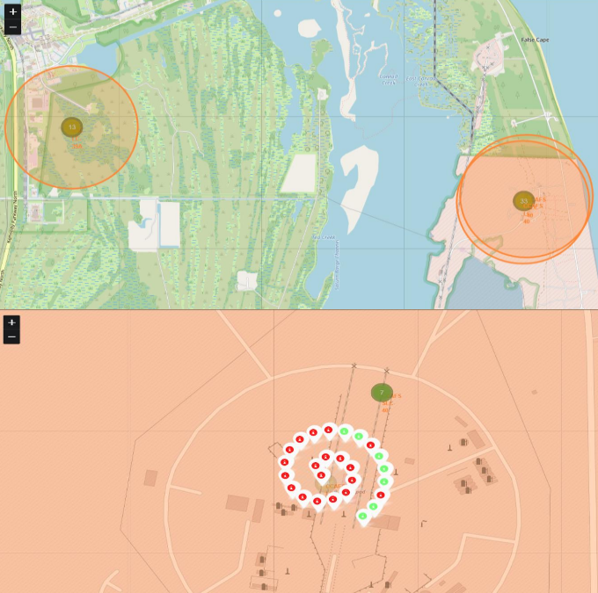
Successful and failed launches by site
We used markers with green to indicate a success and a red one to indicate a failure clearly

Slide 37
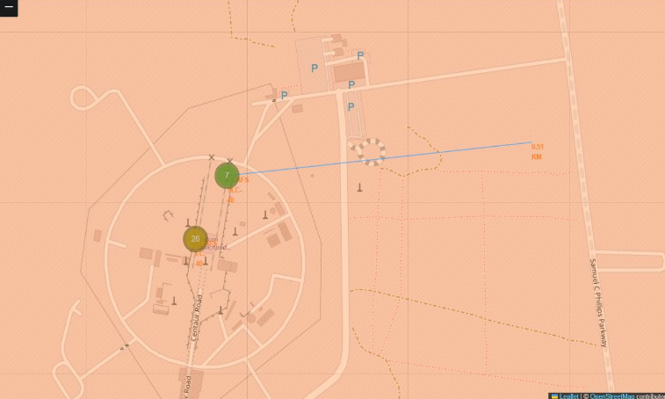
Launch site and near proximities
We used folium to display the diustance to the coastline

Slide 38

Section 4

Slide 39
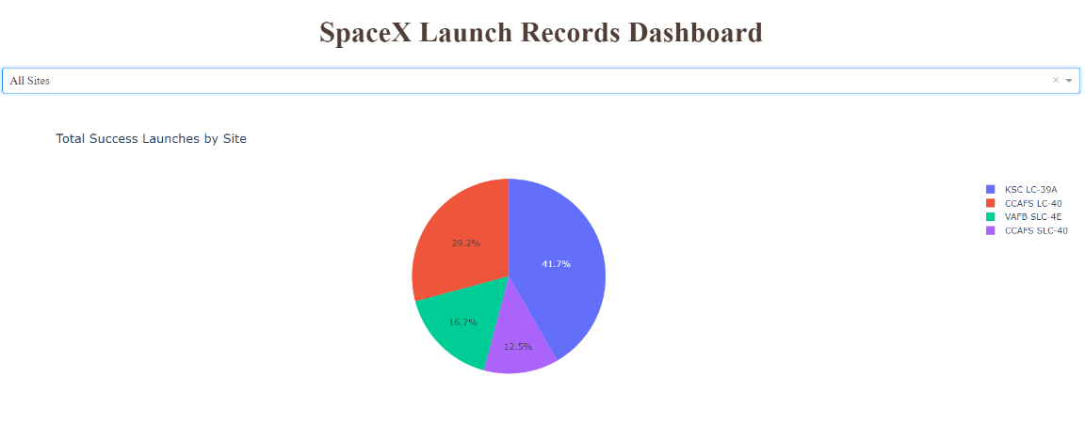
Launch success for all the sites
We used a pie chart to display the success percentage for each site

Slide 40
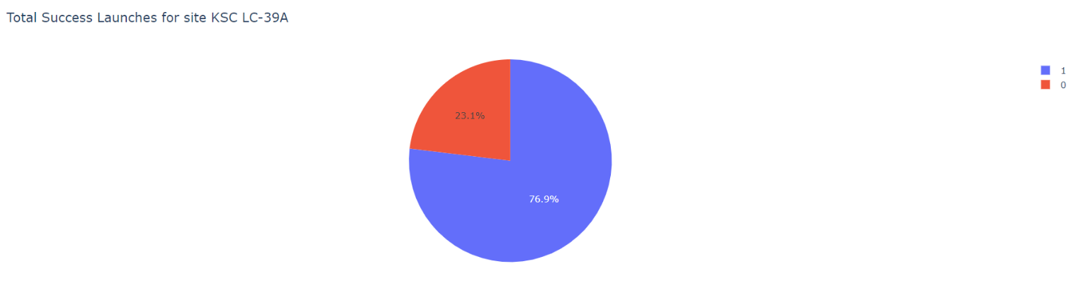
Chart to display the highest success ratio
We used a pie chart to display this information too

Slide 41
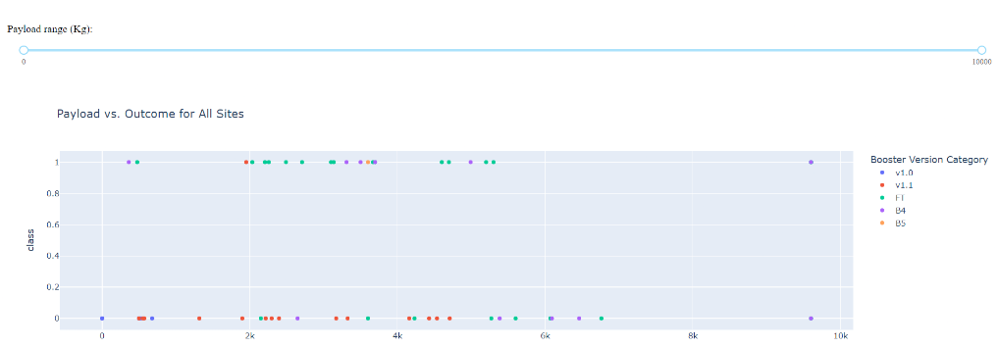
Payload vs outcome charts on dash
We used a scatter plot to plot this information and through all this we found that CCAFS LC-40 has the most successful launch rate and others have low rates
But we were unable to find a drastic correlation between payload and outcome

Slide 42

Section 5

Slide 43
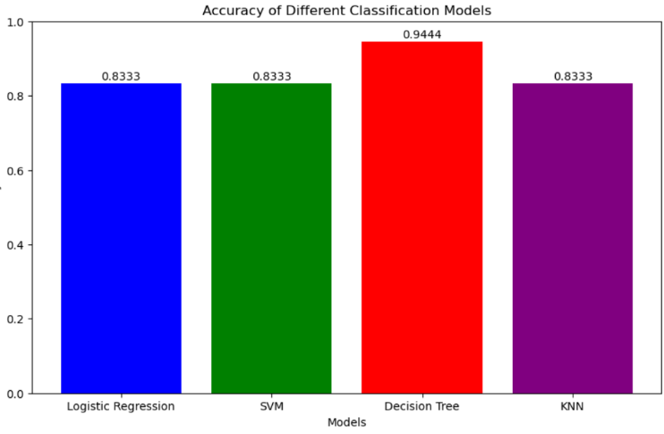
Classification Accuracy
We found that Decision tree model performed the best while all the others like KNN and SVM all showed the same accuracy showing that Decision tree is the clear winner

Slide 44
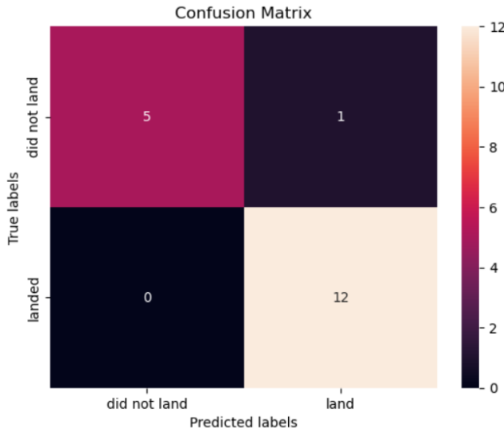
Confusion Matrix
We found that the model showed a 94% accuracy score and with no false negatives and only one false positive it shows a great performance.
While there is one false positive it is very manageable and overall the model shows a very balances performance but it does have a small bias towards predicting successful launches but that aligns with our needs so this model is overall a good model

Slide 45
Conclusions
Point 1: Our analysis shows that the CCAFS LC-40 launch site has the highest success rate, contributing to 43.7% of all successful launches. This suggests that the site may offer favorable conditions or operational advantages that consistently support successful landings.
Point 2: The scatter plot analysis indicates that the FT booster version maintains a high success rate across a wide range of payload masses. This highlights its reliability and robustness compared to other booster versions and suggests that future missions could benefit from using this variant to improve success outcomes.
Point 3: We found no strong correlation between higher payload mass and lower landing success rates. This implies that variables such as launch site conditions and booster version type have a more substantial impact on mission success than payload mass alone.

Slide 46


